Slide 1
Candidates & Agents Briefing
Tuesday 24 March 2026 @ 5pm
Norfolk County Council Election (7 May)

Slide 2
Introductions
Caroline Clarke
NCC / Returning Officer
Kate Blakemore
BCKLWN Chief Executive / Deputy Returning Officer
Michelle Drewery
Deputy Chief Executive & Sec’ 151 Officer / Assistant Deputy Returning Officer
Emma Hodds
Chief of Staff / Assistant Deputy Returning Officer
Andrew Barrett
Electoral Services Manager / Assistant Deputy Returning Officer
Electoral Services

Slide 3
Election Timetable
Electoral Commission website (full timetable)
Notice of Election Friday 27 March
Close of Nominations / Withdrawals Thursday 9 April (4pm)
Statement of Persons Nominated Friday 10 April (4pm)
Election Registration Deadline Monday 20 April
Postal Vote Application Deadline Tuesday 21 April (5pm)
Photo-ID VAC Application Deadline Tuesday 28 April (5pm)
Counting / Polling Agents Deadline Wednesday 29 April
Replacement Postal Votes (first date) Thursday 30 April
Candidate Expenses Deadline Friday 12 June
Electoral Services

Slide 4
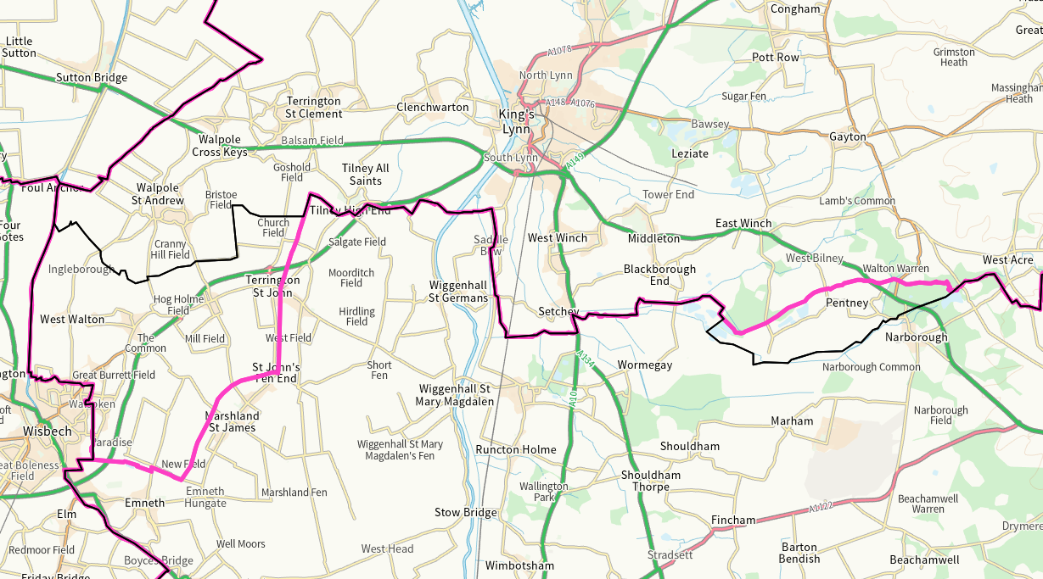

Slide 5
Existing NCC Boundaries – 14 Divisions
Clenchwarton & King’s Lynn South | Dersingham
Docking | Downham Market
Feltwell | Fincham *
Freebridge Lynn | Gayton & Nar Valley *
Gaywood North & Central | Gaywood South
King’s Lynn North & Central | Marshland North
Marshland South | North Coast
Electoral Services

Slide 6
NEW NCC Boundaries – 14 Divisions
Clenchwarton & King’s Lynn South | Dersingham
Docking | Downham Market
Feltwell | Freebridge Lynn
Gaywood North & Central | Gaywood South
King’s Lynn North & Central | Marshland North
Marshland South | Nar & Wissey Valleys **
North Coast | Watlington & The Fens **
Electoral Services

Slide 7
Boundary Changes
https://lgbce.maps.arcgis.com/apps/instant/basic/index.html?appid=b35e8415b83347ae8ed4ecb7104bb99e
Electoral Services

Slide 8
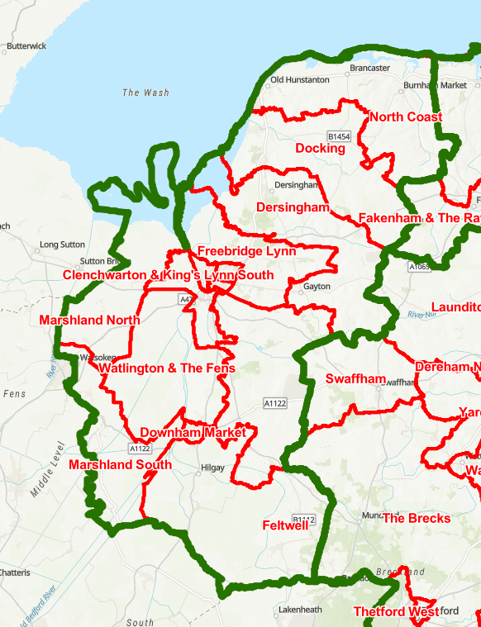
Boundary Changes
Electoral Services

Slide 9
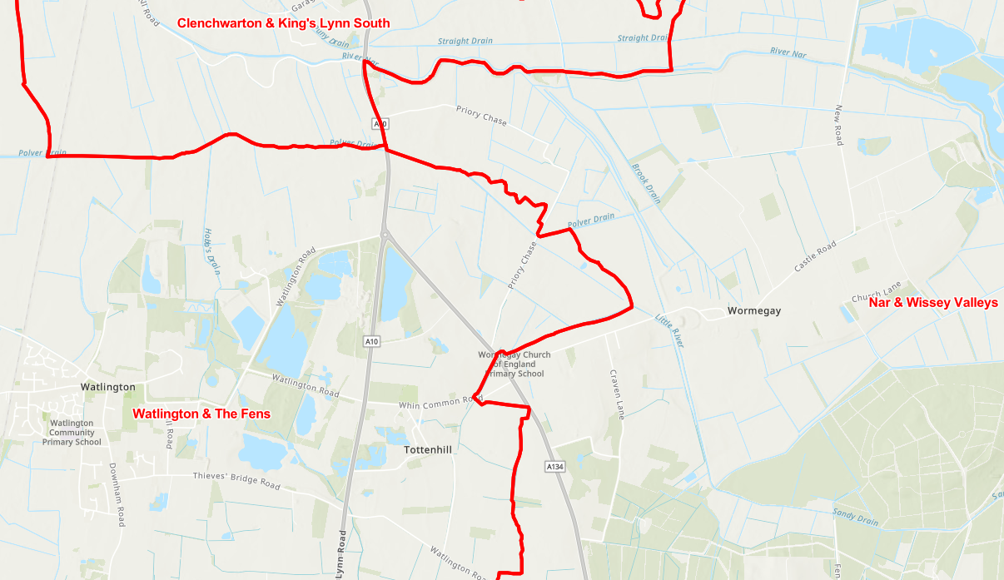
Boundary Changes
Electoral Services

Slide 10
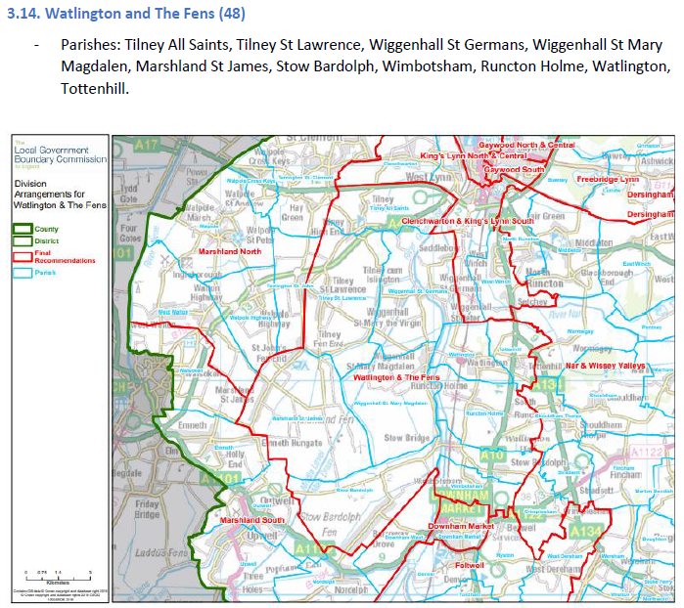
Boundary Changes
Electoral Services

Slide 11
Poll Cards
First Despatch (Bulk) Tuesday 24 March
Hitting Doormats Thursday 26 / Friday 27 March
Late Despatch Wednesday 29 April
Hitting Doormats Friday 1 / Saturday 2 May
Electoral Services

Slide 12
Postal Votes
First Despatch (Bulk) Monday 20 April
Hitting Doormats Tuesday 21 April
Late Despatch Monday 27 April
Hitting Doormats Tuesday 28 April
Electoral Services

Slide 13
Supply of Information
Electoral Registers / Absent Votes Lists (from 27 March)
Marked Polling Station Registers (available after the election – at a cost)
Marked Absent Votes Lists (available after the election – at a cost)
Please send requests to: elections@west-norfolk.gov.uk
Supplied in Data format (or via paper if requested)
Electoral Services

Slide 14
Nominations (1 of 2)
Nomination Packs / Guidance: Electoral Commission website
www.west-norfolk.gov.uk/UpcomingElections
2 subscribers required (within the same County Division)
Check elector numbers against the Electoral Register (2 March 2026)
Qualifications to stand as a Cllr (Candidates’ Responsibility)
Candidate Description: Registered Political Party Description / Independent / Blank
Include ALL pages (even if blank)
Electoral Services

Slide 15
Nominations (2 of 2)
Informal checks (by e-mail)
Formal delivery of Nomination Papers (Monday 30 March – Thursday 9 April between 10am- 4pm)
Must be delivered by hand:
Please make an appointment where possible
By: Candidate, Election Agent or Proposer/Seconder
Tel: 01553 616773 or E-mail: elections@west-norfolk.gov.uk
Main Reception of BCKLWN Offices @ King’s Court
Early submission is recommended in case of errors
Open to public inspection
Electoral Services

Slide 16
Candidate Literature / Guidance
NOT the responsibility of the Returning Officer or Elections staff to check qualification information or offer guidance
Ultimate responsibility lies with Agent / Candidate
Imprints on ALL printed campaign materials (including electronic)
Please read Electoral Commission Guidance
Any issues will be referred to the Police ‘SPOC’ (Electoral offences)
Electoral Services

Slide 17
Campaigning
“Campaigners are an essential element of a healthy democracy, and their right to put their arguments to voters should be supported and protected. It is equally important, however, to ensure that the activities of campaigners do not bring into question the integrity of the electoral process.”
Full Guidance: Electoral Commission website
Electoral Services

Slide 18
Registration
Candidates uniquely placed to encourage people to register to vote
Deadline to apply for these elections: Monday 20 April
No need to re-register if already registered
www.gov.uk/registertovote (easiest and fastest method)
Encouraging people to have a postal vote?
Explain they must be registered first
Apply in time (5pm Tuesday 21 April)
Electoral Services

Slide 19
Voter-ID (What we are doing locally)
Poll Cards
Social Media
Parish / Local publications
Electoral Services

Slide 20
Polling Stations
105 Polling Stations
11 Polling Stations will have two ballot boxes due to overlapping boundaries
Situation of Polling Stations is published by 5pm Tuesday 28 April
Polling Station Inspectors
Electoral Services

Slide 21
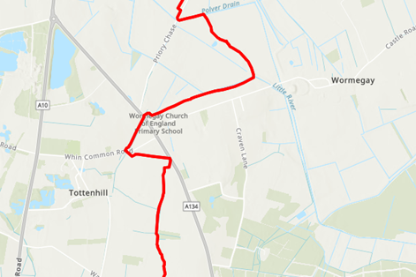
Electoral Services

Slide 22
Voter Authority Certificate (VAC)
Individuals who do not have or wish to use one of the accepted forms of Photo-ID can apply for a Voter Authority Certificate (VAC)
Online or Paper application form
https://www.gov.uk/apply-for-photo-id-voter-authority-certificate
Electoral Services

Slide 23
Postal Vote – Opening Sessions
Candidates / Election Agents / Sub-Agents / Postal Vote Agents
w/c 20 April (@ BCKLWN offices in King’s Court)
Dates / Times TBC
Final session: 7 May 10pm @ Lynnsport (count venue)
Please provide notification of attendance beforehand
At least 24 hours notice will be given for any changes to arrangements/cancellations.
Sessions are dependent on quantities of votes received
Electoral Services

Slide 24
Verification / The Count – Friday 8th May
Alive Lynnsport Leisure Centre
Admittance from 8.30am
Enter through main entrance (via reception)
Verification will begin Friday 8 May @ approx. 9.00am
All County Divisions will be verified before counting begins
Count will begin @ approx. 12.00-1.00pm
7 tables / 6 counting assistants each
Each table will verify/count 2 County Divisions
Security on the entrance doors and inside the main hall
Electoral Services

Slide 25
Verification / The Count
Only ‘appointed’ persons may attend
Election Staff
Media
Candidates + Candidate Guest x 1
Election Agent
Counting Agents x 2 (max)
One additional Counting Agent may be appointed if multiple candidates share an Election Agent
Lanyards will be provided – must be worn throughout
Collect your lanyard upon first arrival at the door of sports hall
Only allowed to oversee the County Division where you have been appointed
Electoral Services

Slide 26


Slide 27


Slide 28


Slide 29
New Councillor Induction
If you are elected as a County Councillor, you will be invited to County Hall to sign your declaration of office, meet key staff and begin your councillor induction.
At the count venue, following the declaration of results, an NCC officer will be present to offer their congratulations and provide you with your Welcome Pack.
We plan to be ready to meet new councillors from Tuesday 12 May, but the Welcome Pack will provide more information and timing of events being held that day and the rest of the week.
Included will be a letter from NCC Chief Executive, Tom McCabe, together with a number of forms which you will need to complete and bring with you to your induction. There will also be contact information if you need to speak to us before you come in.

Slide 30
Candidate Expenses
Deadline: Friday 12 June
Submit to the Returning Officer (Caroline Clarke @ NCC)
Must submit even if NIL expenses were incurred
Remember Agent & Candidate’s Declaration
Available for public inspection
Responsibility of Election Agent (or Candidate)
Check Electoral Commission Guidance
Electoral Services

Slide 31
Candidate Expenses
Fixed amount of £960 per Division + additional 8p per Registered Elector
Eligible electorate figure on 27 March 2026 (Notice of Election)
Example ONLY: £960 + (8,000 x 0.08) = £1,600
Electoral Services

Slide 32
Contact Details
General contact details (BCKLWN Electoral Services):
E-mail: elections@west-norfolk.gov.uk
Tel: 01553 616773
Kate Blakemore ( DRO ):
E-mail: kate.blakemore@west-norfolk.gov.uk
Tel: 01553 616245
Andrew Barrett ( ESM / ADRO ):
E-mail: andrew.barrett@west-norfolk.gov.uk
Tel: 01553 616306

Slide 33
End of presentation
Any other questions?
Electoral Services

