Slide 1
Kings Lynn & West Norfolk – 2017 District CO₂ Emissions Bubble
- An Overview of the 2019 BEIS Data

Slide 2
Background Information
BEIS = The Department of Business Energy & Industrial Strategy.
They publish local authority emissions data on a yearly basis.
Data is on a 2 year rotation, therefore they report on CO₂ emissions two years prior to the report data i.e. the 2019 publication reported 2017 CO₂ emissions.
The 2020 publication will report 2018 CO₂ emissions.
Emissions are allocated on an ‘end user’ basis, where emissions are distributed according to energy consumption. Emissions from goods production (apart from the energy industry) are allocated to where production takes place, which therefore, excludes imported goods.

Slide 3
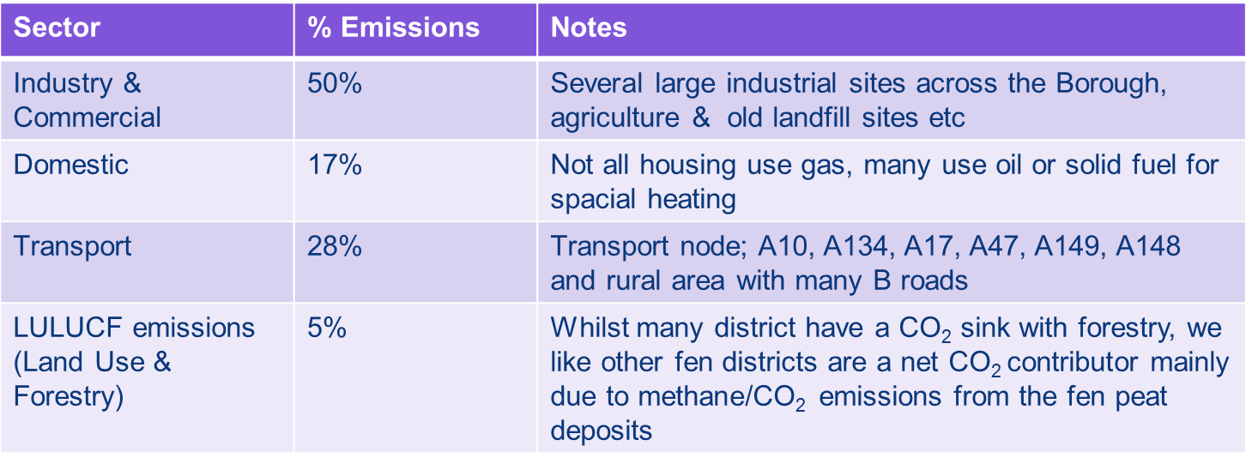
CO₂ Emissions Overview
CO₂ emissions in 2017 totalled at 1,405.3 Kilo-tonnes (kt).
Emissions are split into 4 sectors:

Slide 4
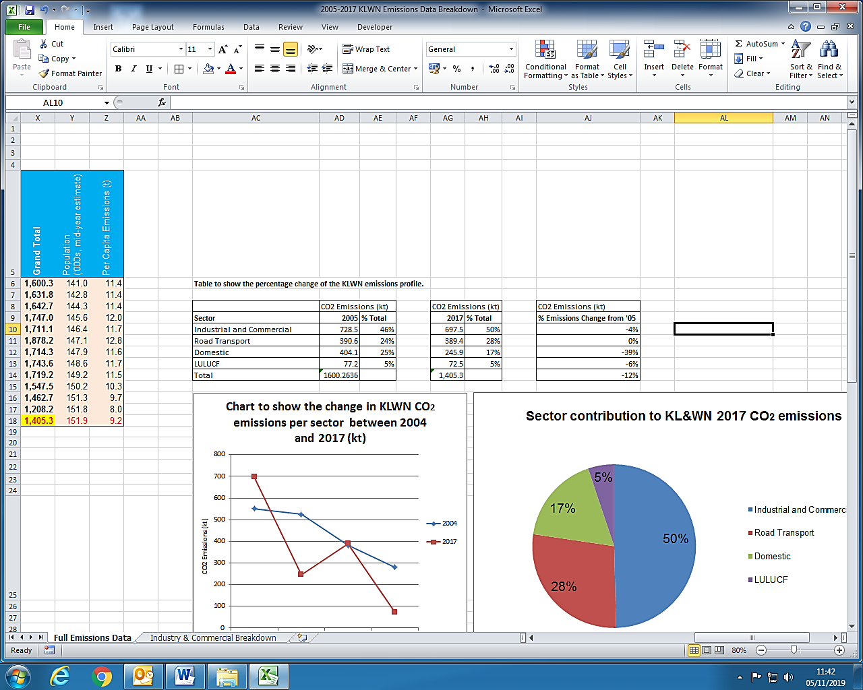
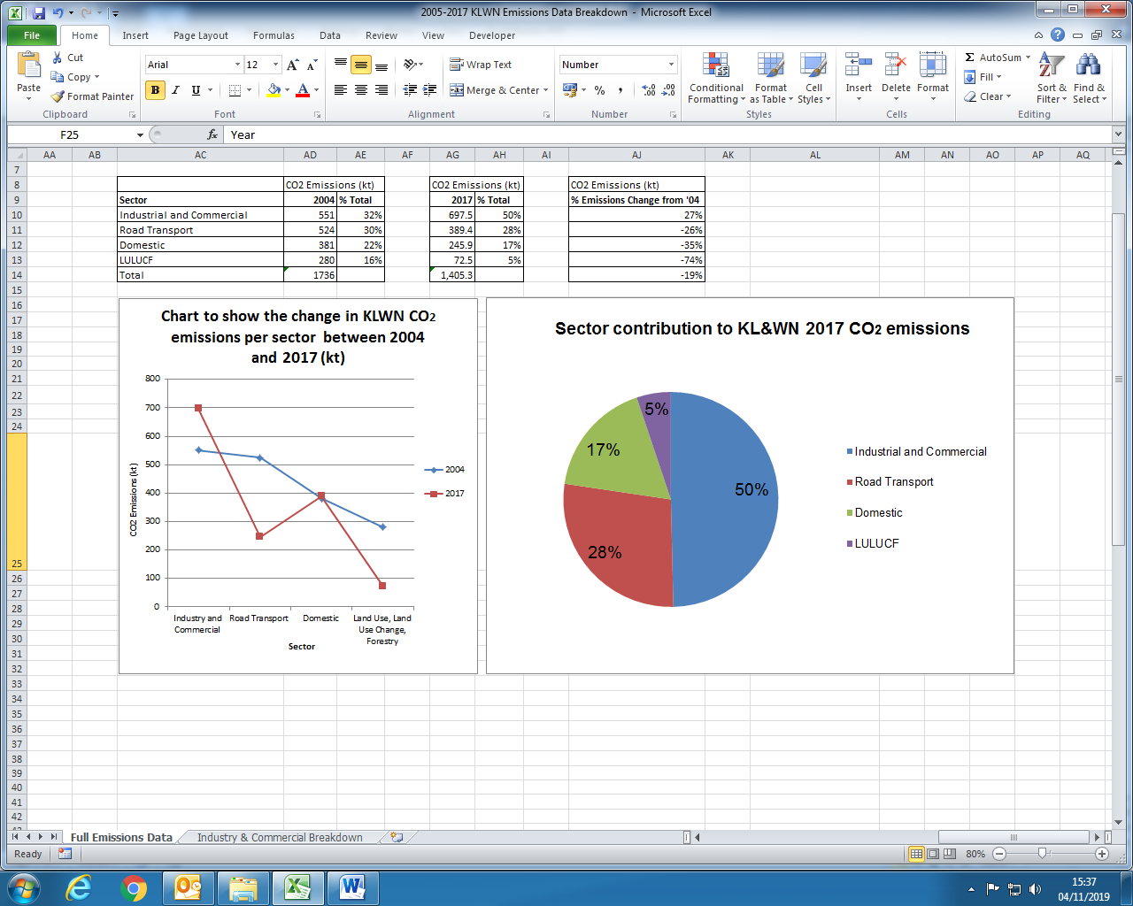
CO₂ Emissions Overview
CO₂ emissions from each sector are listed below.
Their percentage contribution to district emissions are portrayed in the pie chart.

Slide 5
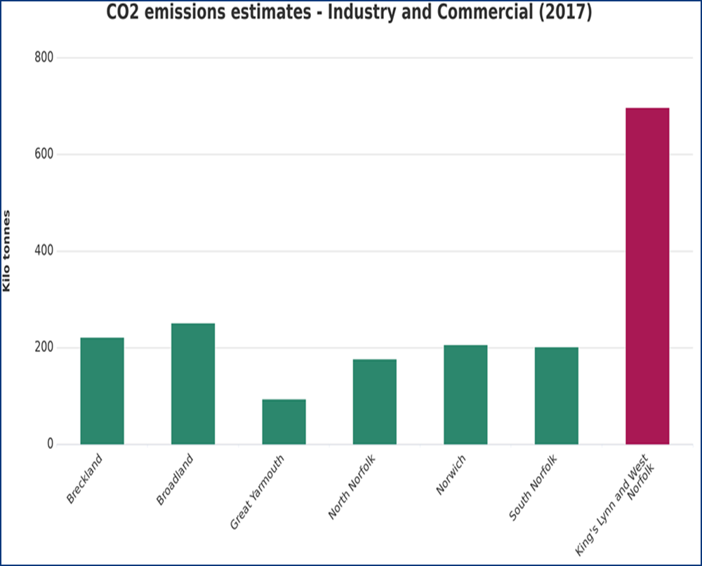
District Comparisons

Slide 6
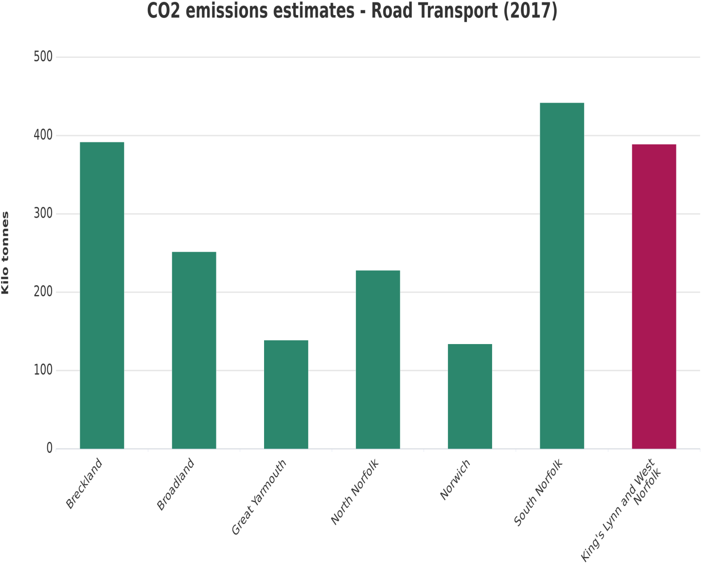
District Comparisons

Slide 7
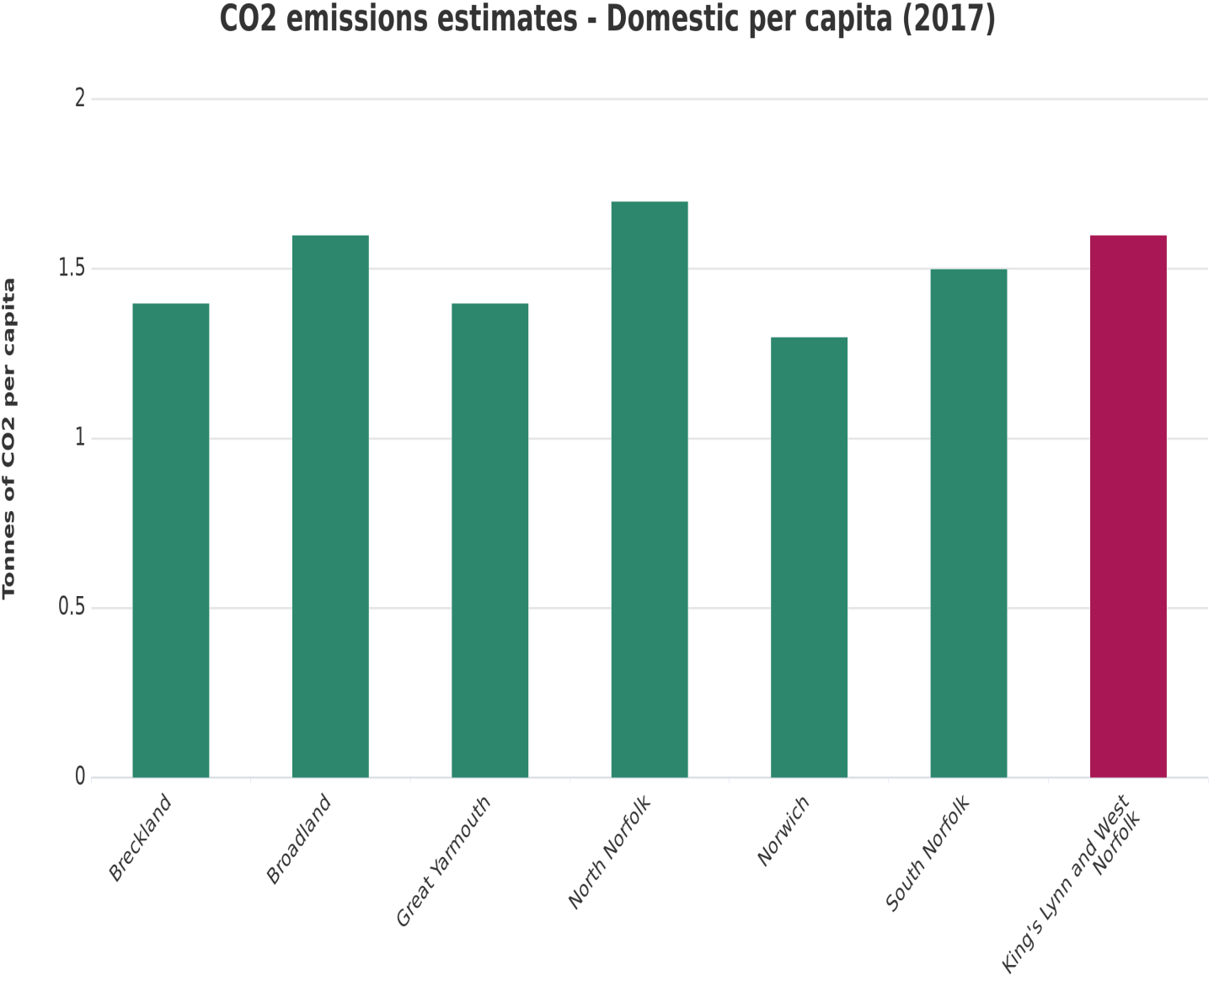
District Comparisons

Slide 8
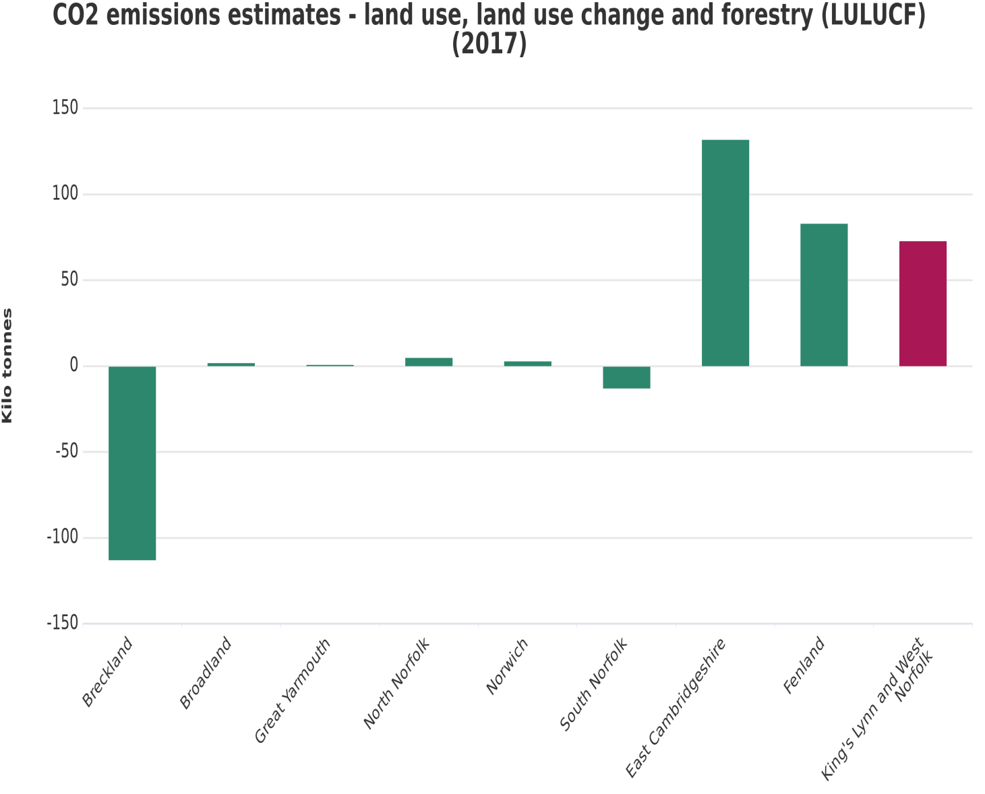
District Comparisons

Slide 9
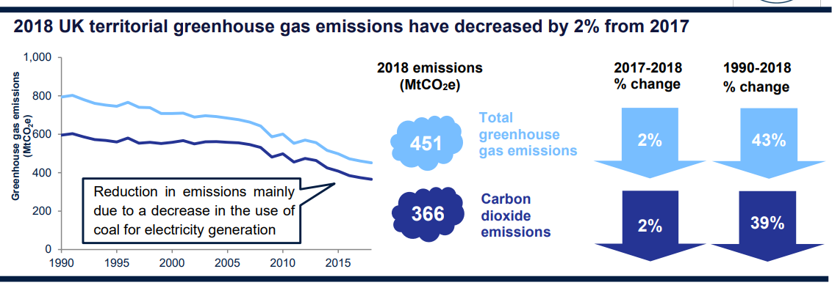
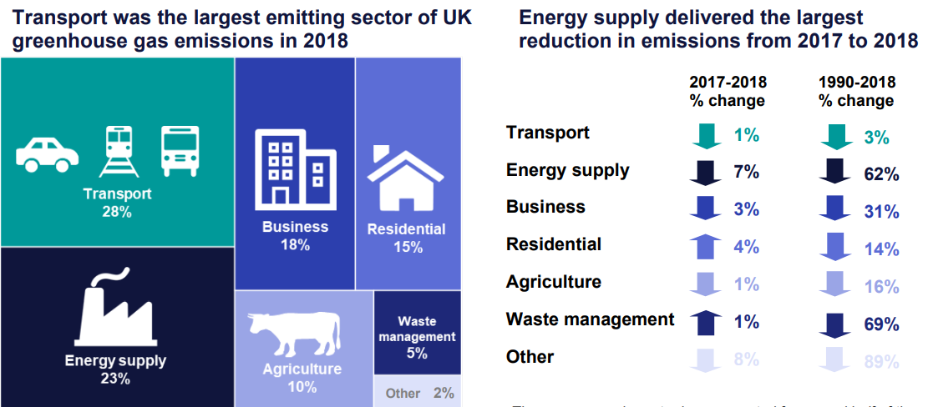
2018 UK Wide Greenhouse Gas Emissions

